Slide 1
Operating Systems
By Cody Hohenberger, Tyler Bayless, Pietro Augusto De Ouro Preto, and Petar Krivokuca

Slide 2
Operating systems
An operating system (OS) is system software that manages computer hardware, software resources, and provides common services for computer programs.

Slide 3
Windows
Windows is a multitasking operating system for computers and mobile devices, developed by Microsoft in 1985, one of the most used around the world. Since then, this operating system has evolved,in terms of functionality, design and efficiency. So far, Microsoft already has dozens of updates, the most recent is the Windows 10.
Several products are part of the Microsoft Windows "family," such as Windows Live, Windows Media Center, Windows Media Player, and other softwares that have been developed exclusively to enhance the performance of microsoft-made operating systems.
The functions of the Windows operating system is to facilitate the user's access and to be more efficient, attractive and with more easy-to-use interfaces, besides to have faster and more effective softwares.

Slide 4

Mac OS is the second most used operating system in computers right behind Windows. It was released in 2001 and is a proprietary graphical operating system developed and marketed by Apple Inc.
Advantages to using macOS is the fast and easy to traverse interface with FINDER and is great for any types of editing because of the colorsync and spatial anti-alias technology.
Disadvantages include the price to own an apple device, limited number of compatible applications and the operating system doesn’t favor the hardcore gamers.

Slide 5
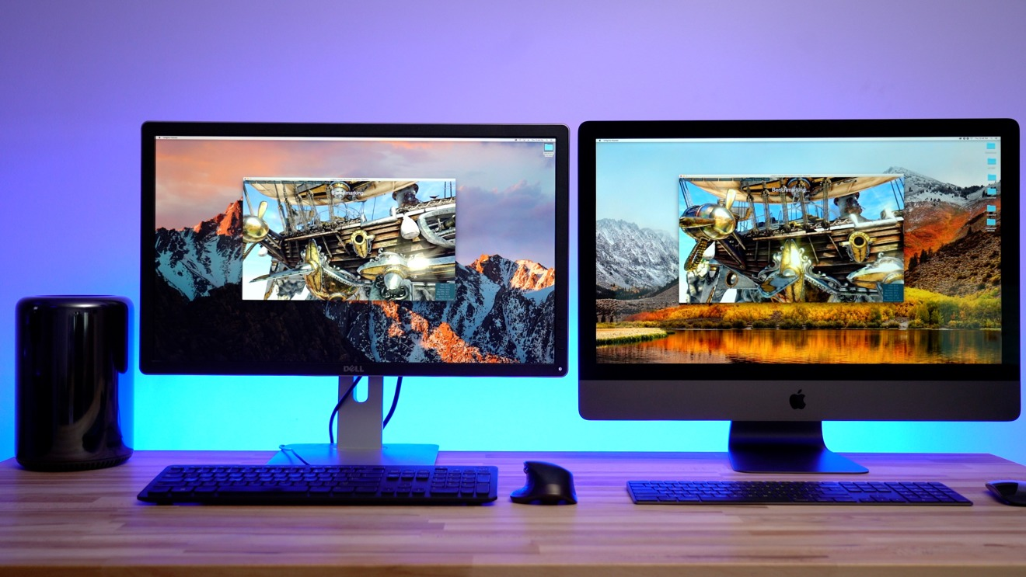

Slide 6

Linux
Linux is an operating system that is completely free, it was developed first in 1991 By a Finnish student Linus Torvalds.
Linux runs faster than windows 10 and it is known for running smooth but it has some disadvantages compared to windows.
there is no standard desktop environment
Gaming experience is not so great
There is no way of packaging software
Software for desktop is still rare

Slide 7

UNIX
Unix was developed by AT&T in the mid-late 1960s. It is considered to be one of the most powerful and popular multi-tasking operating systems.
Allowed multiple users to access the a mainframe at the same time
Provides multi-tasking
First OS written in a high-level language
Users can easily exchange information

Slide 8
Youtube link:
https://youtu.be/jsOKdw1Yqo4

